Slide 1
Reversi / Othello
Improved AI
By David Chen and Nicola D’Addamio

Slide 2
Othello rules
First player is random
The game ends when any player cannot play a move
A disc may outflank any number of discs in one or more rows in any number of directions at the same time (horizontally, vertically or diagonally -- as long as in a continuous straight line).
You cannot skip over your own color.
Disc(s) can only be outflanked as a direct result of a move and not as an aftereffect .
All discs outflanked in any move must be flipped, even if it to the player’s advantage not to flip them all.
If a player makes a mistake in flipping discs, it can be corrected as long as the opponent has not made a move after that. If the opponent has made a move, it is too late to change them back.
A disc cannot be moved after it is placed on the board.
Note: It is possible for a game to end before all 64 squares are filled.

Slide 3
Overall Goal
Our main and only focus is to improve the original AI and be able to get the advantage over it by having consistent and re-creatable statistics.
Original AI source code (python):
https://inventwithpython.com/chapter15.html

Slide 4
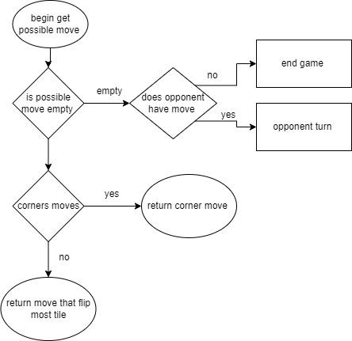
Original AI Flowchart

Slide 5
Original AI
Ai would look at board state and get all possible move in array then randomized the array
AI checks if the possible next move includes a “corner move”, if yes, play the corner move, if not, play the best move.
Looks for the move that does the most flips from a random given list of moves.
And repeats until a move cannot be made anymore or a player wins.
Note: very simple and randomized AI that plays with a brute force method.

Slide 6
Improve AI
High Priority list of moves.
Remove the random aspect of the old source code to select the next move.
Try to take over the corners of the board and then the edges (which is the next important strategy).
Low priority list places for the AI to avoid or “pay less attention”.
Avoid mid rows and columns outside the 4*4 center square. For example row 2,7 and column 2,7 (these locations are very easy to overtake and can cause access to outside edges and corners).
Leave the corners out for last to select as final moves.
At the start of game, try to only play in the center 4x4 until required or opposite player plays outside of such square.

Slide 7
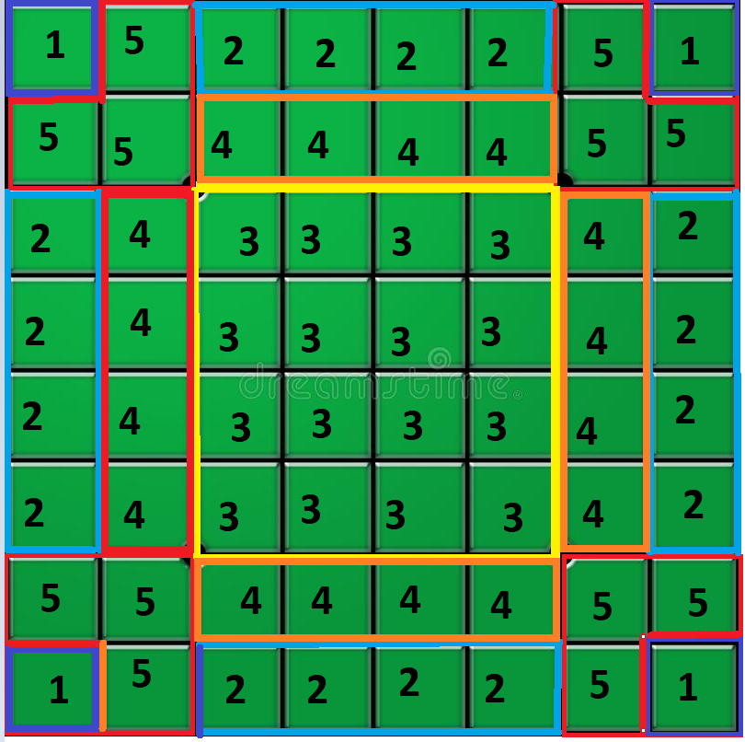
Improved AI - Priority scale
Check if any possible moves are
Corner
Edge
Center 4*4 spots
Located on row 2 or 7 and column 2 or 7
Spots adjacent to corners

Slide 8
Improve AI
Reduce option
During the mid game, the main strategy is to maximize the number of available moves, while minimizing your opponent's moves. Keeping your pieces grouped together gives your opponent fewer options to play.
If their multiple move that flips the same amount of time we would play he move that give the opponent the least amount of move
Force bad move
If you are forced to make a bad move late into the game, it is usually a good idea to play in an area where an odd number of empty squares are left.
Safe move
Check for tiles that cannot be flipped with a another move (like a corer tile) and play that. This would assure a possible way to come back during late game that utilizes that safe tile

Slide 9
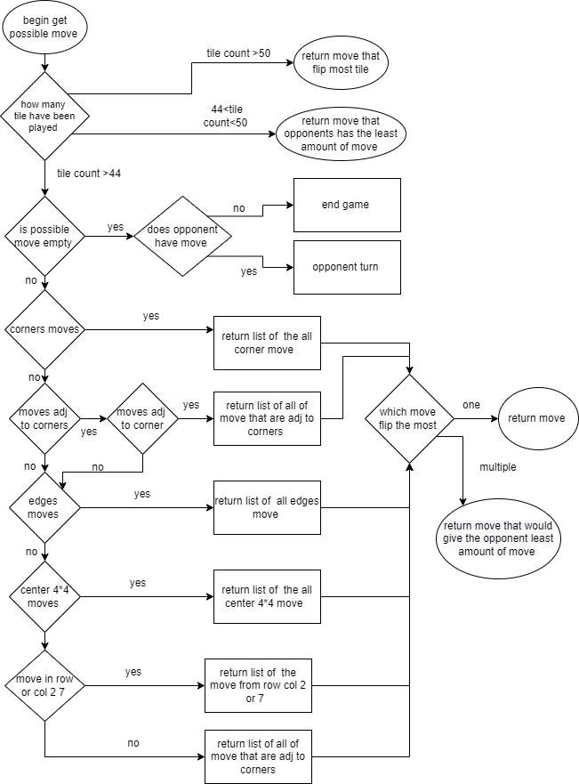
Improved AI Flowchart

Slide 10
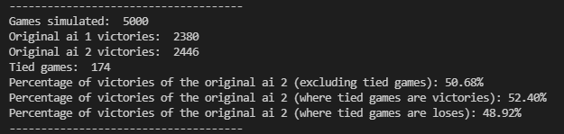
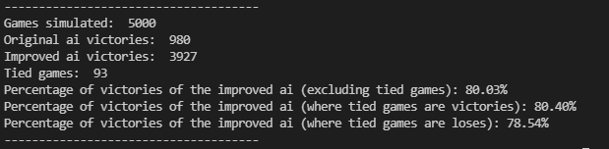
Old AI vs Improved AI

Slide 11
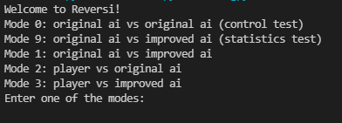
Game modes
These are the modes that are available in the improved code. Where mode 0 and 9 are mostly for debugging and testing purposes.
Modes:
0 - Original AI vs Original AI (used as a control group)
9 - Original AI vs Improved AI (used as statistics)
1 - Original AI vs Improved AI (with step by step plays)
2 - Player vs Original AI (with step by step plays)
3 - Player vs Improved AI (with step by step plays)

Slide 12
player move
Once we get any input we would check
Quits - ends game
Hints - displays all possible move
Move -To make a move you will enter (y,x) like 35 for col 3, row 5
Valid move- updates move and then ai plays
Invalide move- displays invalid move and waits for another input

Slide 13


Slide 14


Slide 15
References
Othello.pdf (fgbradleys.com)
http://mcts.ai/code/python.html
Reversi - Wikipedia
How to play Othello | Official Rules | UltraBoardGames
Tips to win Othello | UltraBoardGames
Strategy Guide for Reversi & Reversed Reversi (samsoft.org.uk)

